Slide 1
Literature Review Part Presentation of chosen theses for CSE 596 course.
Theses- Using PLM(Pretrained Language Models) for Toxic Comment Classification
Group 5
Members-
Md. Sayadul Hoque (2235106650)
Moinul Hasan Sifat(2235015650)
Bristy Cathrin(2235366650)
Muntaka Sayef(2235082650)

Slide 2
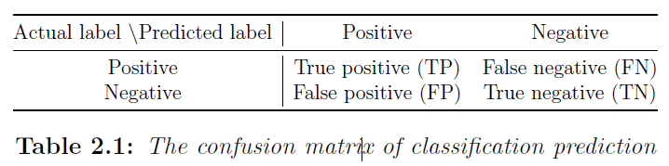

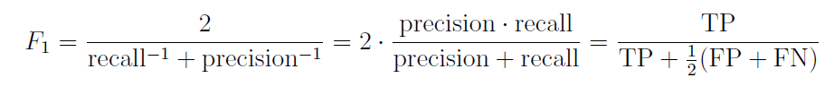
What is Text classification?
Text classification is a common task in NLP. It aims to classify given texts or documents into appropriate categories according to their content.
There are two types of text classification: (1) Binary text classification (2)Multi-label text classification.
There are two types of dataset for text classification: (1) “Labelled” dataset for Supervised learning (2) “Un-labelled” dataset for Unsupervised learning.
Text classification task consists of: (1) Data pre-processing (2) Feature extraction & representation (3) Model training (4)Model evaluation.
Some common evaluation metrics of model evaluation part(binary classification) are: (1) Recall (2) Precision (3) F1 score.
Some common evaluation metrics of model evaluation part(Multi-label& multi class classification) are: (1) Hamming loss (2) Micro average (3) Macro average (4) Ranking loss.

Slide 3
Toxic Comment Classification
The detection of toxic comments can be treated as a text classification problem, which intends to classify comments into different categories, which are categories of toxic comments (e.g., “sexist”, “racist”, “hate speech”, and “abusive language”) and categories of non-toxic comments (i.e., “clean” or “healthy” comments), following the framework of text classification.
The goal is to filter out such comments and prevent them from being posted on social media platforms or other online forums.
Recently, pre-trained language models such as BERT, GPT-2, and RoBERTa have shown promising results for this task.

Slide 4
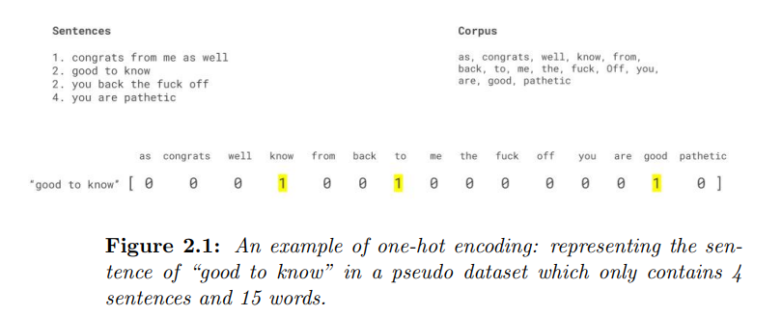
Features
Before discussing different features, Firstly we want to briefly introduce how to encode features. One-hot encoding is a basic approach which uses binary identifiers (0 or 1) to indicate the presence or absence of a feature where each feature is represented as a unique dimension.
(1) Surface features (2) Sentiment Analysis features (3) Lexical Resources (4) Linguistic Features (5) User-based Features
Surface Features:
There have 2 types of surface features:
Skip-gram
Term Frequency-Inverse Document Frequency (TF-IDF).
Manually Engineered features

Slide 5
Skip-gram: Skip-gram is one of the unsupervised learning techniques used to find the most related words for a given word. Skip-gram is used to predict the context word for a given target word.
TF-IDF: TF-IDF (term frequency-inverse document frequency) is a statistical measure that evaluates how relevant a word is to a document in a collection of documents. This is done by multiplying two metrics: how many times a word appears in a document, and the inverse document frequency of the word across a set of documents.
Sentiment analysis Features:
Sentiment analysis is a natural language processing (NLP) technique used to determine whether data is positive, negative or neutral.
For example: Disliking horror movies is not uncommon.
Lexical Resources:
There are several publicly available lexical resources related to toxic comments which could be predictive. For instance, Hatebase is a lexicon focusing on hate-related terms. It includes 3879 terms regarding hate speech towards different nationality, ethnicity, religion, gender, sexual discrimination, disability and minority groups . HurtLex is a hand-crafted lexicon of offensive, aggressive and hateful words. Its original version is in Italian and then it is semi-automatically translated into 67 languages
Linguistic Feature:
Due to the complexities in language grammar and syntactic relationships, it is common for the same words to have different meanings when they appear in different orders. Therefore, linguistic knowledge can be introduced to indicate word relationships.
There are two popular linguistic features: i. Part-of-speech (POS) tagging.
ii. Typed dependency parser.

Slide 6
POS tagging: POS tagging is the process of marking up a word in a text (corpus) as corresponding to a particular part of speech, based on both its definition and its context.
Typed dependency parser: Typed dependency relationship analyses the grammatical structure of a sentence, identifying relationships between words. For example: I know those people, who are poor.
User-based features:
User-based features utilise the user/publisher (i.e., who post the comment) information, such as their age, gender, location, number of friends and social network, conventionally seen as auxiliary features of content-based features.
For example: Put on a wig and lipstick and be who you really are.
Abstract features - word embeddings
There are 3 types of word embedding: i. Context-independent embedding
ii. Context-sensitive embedding
iii. From word embeddings to paragraph embeddings
Context-independent embeddings:
Contextual embedding is a technique used in Natural Language Processing (NLP). Contextual embeddings assign each word a representation based on its context, thereby capturing uses of words across varied contexts and encoding knowledge that transfers across languages.
Two type of Context-independent embeddings:
Word2Vec
GloVe

Slide 7
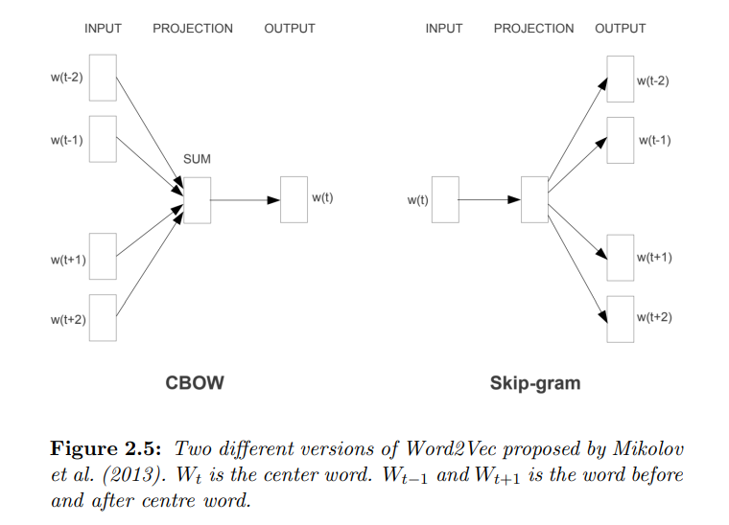
Word2Vec: Word2Vec is trained on language modelling tasks which aim to predict the centre word based on the context (Continuous Bag-of-Words Model, as denoted as “CBOW”) or to predict the context of the centre word (Continuous Skipgram Model).
GloVe: GloVe is a count-based statistic language model, counting the co-occurrence of words in the context. GloVe is an unsupervised learning algorithm for obtaining vector representations for words. Training is performed on aggregated global word-word co-occurrence statistics from a corpus, and the resulting representations showcase interesting linear substructures of the word vector space.
Context-sensitive embeddings:
Context-sensitive embeddings has two popular embedding systems:
CoVe and Elmo

Slide 8
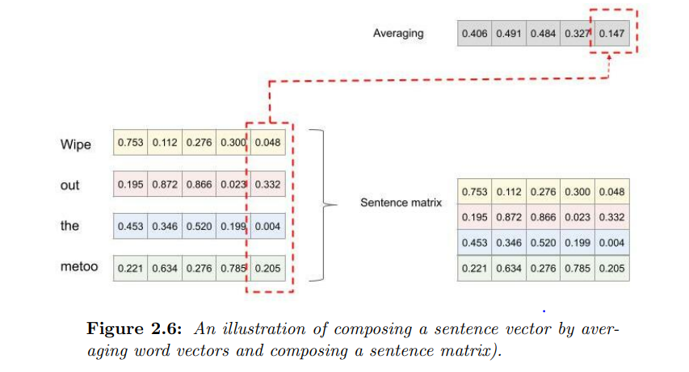
CoVe, or Contextualized Word Vectors:
CoVe stands for Contextualized Word Vectors, derived from a English-to-German machine translation model. The sequence-to-sequence machine translation model consists of an encoder and a decoder. The encoder is pre-trained to encode the sequence of words, i.e., sentence, from the original language (English) to an “intermediate language” (also can be thought as a intermediate representation). The decoder is to decode the “intermediate language” into the target language (German).
Embeddings from Language Models:
Elmo is a newer context-sensitive word embedding model proposed one year after CoVe was published. Like CoVe, Elmo is derived from a pre-trained model, and is subsequently transferred to the downstream task. The main difference is that Elmo trains on an unsupervised language model rather than a supervised translation model utilized by CoVe.
From word embeddings to paragraph embeddings:

Slide 9
Algorithms for Toxic Comment Classification
Traditional Machine learning:
Logistic Regression:
It is a special regression used to model the probability of a certain class.
It leverages the logistic function to take any input data and outputs a value between zero and one, which can then be used to classify an instance by a cut-off value.
Naïve Bayes:
This classifier calculates the probability of an event based on prior knowledge of conditions that might be related to the event.
In the task of text classification, this classifier computes the posterior probability of a class based on the distribution of features in general in the document.
This works with the “bag of words” assumption. In “bag of words”, a sentence or document is represented as the pool of its words, disregarding grammar and word orders.

Slide 10
Decision tree classifier:
It consists of decision nodes and leaf nodes. Each decision node splits input data into two or more downstream nodes connected to it according to a single feature.
The downstream nodes repeated this step according to another feature until passing the data to leaf nodes. Each leaf node indicates a class that is the result of an instance.
In the context of text classification, each text document is the input data which will be assigned to a class, i.e., a leaf node, after passing through layers of decision nodes.
Support Vector Machine:
It represents instances as points in a high dimensional feature space where each dimension is a feature.
The basic concept of Support Vector Machines is to find the optimal hyper-plane to separate training data points as much as possible according to their classes. The points of two classes closest to the decision plane are called the support vector.
The machine learning process is to maximize the margin between support vectors from different classes.

Slide 11
Neural network based methods(deep learning):
Forward Pass
Superficial features like shape & color of an image
Higher level features
Need to describe:
(1)How error or loss function is calculated here?
(2)Some loss functions: absolute error, mean squared error, cross entropy loss, negative log likelihood loss, Gaussian negative log likelihood loss
(3)What is epoch?
(4)What is a good epoch number?
(5)What is over-fitting?
(6)How regularization can mitigate overfitting?
Probability calculation using Sigmoid or SoftMax function
Input data as batch
Backward Pass

Slide 12
Convolutional Neural networks:
7X5 matrix
Abstract feature
Pooling layer such as max polling & average pooling
5d Word vectors as feature

Slide 13
Recurrent Neural Networks(RNN):
Memory
Information from long distances before
will vanish in the later time steps and the information from the close distances
will dominate.
An comparison of data processing methods between non-
RNN neural networks and RNN

Slide 14
Long Short Term Memory Network(LSTM):
It is a modified RNN model which is good at learning long-term dependencies. It is built on top of RNNs with additional functions of “forgetting” less important information and “remembering” useful information for later time steps.
The vanilla LSTM “reads” text from left to right, just like we humans. To further capture bidirectional LSTM (bi-LSTM) can “read” text from not only left to right but also right to left. Therefore, bi-LSTM captures both the previous and following contexts of a word.
A slight variation of LSTM is the Gated Recurrent Unit (GRU). It combines the “forgetting” function and current word information into a single updating function. The resulting model is simpler and faster to compute.
Attention mechanism in deep learning:
How strong the input
word relates to each word in the rest of entire input text.
A broken down of one single encoder and decoder in Transformer

Slide 15
The attention distribution captured by Transformer

Slide 16
Document representation
for the whole text that rewards sentences which are clues to correctly classify a
document
Taking Inputs as sentence
Extracting words that are important to the meaning of sentence.
Taking Inputs as word
Hierarchical Attention Network

Slide 17
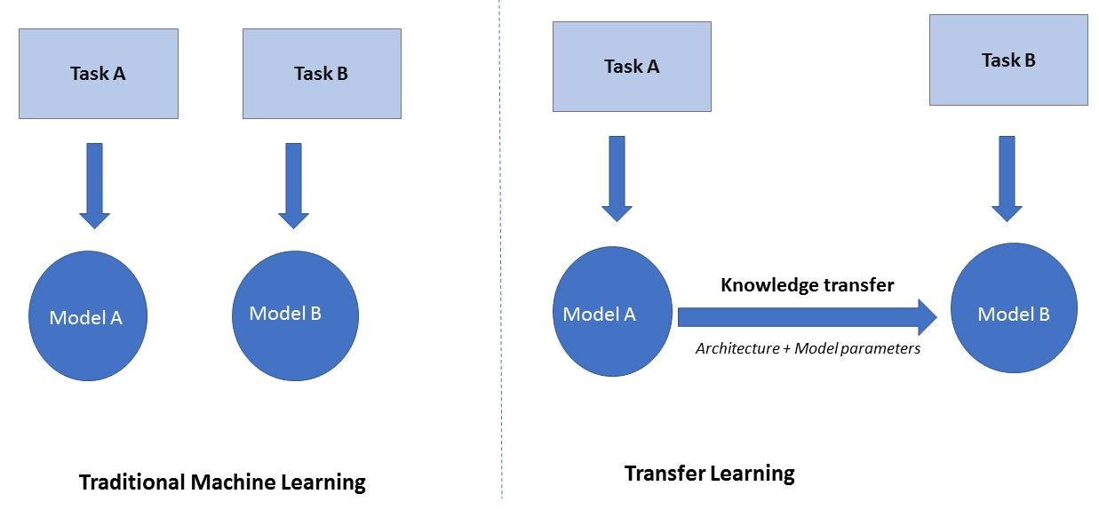
Transfer Learning
Transfer learning (TL) is a machine learning concept that transfers knowledge learned by one model to a second model targeting a separate task.
The first task and its knowledge to be transferred are called the source task & the second task is usually referred to as the target task or downstream task.
The process of TL typically consists of two stages, pre-training and adaptation.
In the first stage, the model is pre-trained on the source task.
In the second stage, the pre-trained model is adapted/transferred to a downstream task and trained on the separate training data.

Slide 18
Pre-training of Transfer Learning
Supervised pre-training:
In supervised pre-training, the model is pre-trained on another labelled dataset that is supposed to be a related task to the target task.
When the source task has very little in common to the target task, the transferred knowledge may harm the target model, also known as negative transfer. For this reason, in many cases only suitable existing tasks are chosen as source tasks for a particular target task.
CoVe is one famous supervised pre-trained model.
Distantly supervised pre-training:
Distantly supervised pre-training is a learning scheme where the classifier is learned on a weakly labelled training set. Here, data are labelled automatically based on heuristics or rules instead of human annotators.
Examples: Sentiment analysis task using emoticons included in a comment as comment’s label, Product review classification and movie review classification by taking start ratings as “loose standard” labels.
Using emoticons, hashtags or star ratings as labels is not that good for work as one group could have some mis-classified comments, i.e., the noisy data, that do not fit in the comments group. For instance, a positive emoticon can indicate sarcasm or a compliment in an otherwise negative text, i.e., a false positive instance.

Slide 19
Adaptation of transfer learning
Unsupervised pre-training:
In contrast to supervised learning, unsupervised learning is a machine learning concept that does not require pre-existing labels for the training data.
Two classic examples of unsupervised learning are clustering and dimension reduction.
Clustering groups data according to its features. Dimension reduction aims to reduce the number of features.
Examples: Language Model such as bidirectional language model & Masked language model.
Adaptation transfers the knowledge learned from the source task to the target task.
Adaptation techniques into two groups: features-based transfer and fine-tuning.
In feature-based adaptation, the pretrained model is taken as the input, fed into the downstream model.
In contrast, fine-tuning adapts a pre-trained model directly and transfer it on the target task.

Slide 20
Feature-based transfer:
In feature-based TL, features are transferred as fixed parameters and weights in transferred layers, known as feature representations or representations, from the source task to the target task.
Word2Vec and Glove can be taken as examples of feature-based adaption. They are both pre-trained on separate source tasks, i.e., language modelling. The representations learned from the pre-training are saved as fixed-vectors that are fed to different downstream tasks.
Fine Tuning:
Fine-tuning TL adapts the source task model to the target model and updates the “knowledge” from the pre-trained model.
The updating mechanism of fine-tuning has the risk of forgetting about what features have been learned from pre-training, a challenge termed catastrophic forgetting.
Universal Language Model Finetuning(ULMFiT) is one of the most popular methods on fine-tuning which can be used for avoiding catastrophic forgetting. ULMFiT uses a gradual unfreezing manner to fine-tune the model.

Slide 21
Pre-trained language model(PLM)
Pre-trained language models (PLMs) are language models pre-trained on source tasks and can be transferred to downstream tasks, especially to supervised tasks.
Training tasks for PLMs:
Statistical language model: It is a neural probabilistic language model which aims to model the conditional probability of the next word given all the previous ones.
Masked language modelling(MLM):The main idea behind it is to mask out some random word tokens in the input sentences and then train the model to predict the masked tokens based on the remaining tokens in the sequence. But it has some limitations.
Permuted language modelling: It is trained to predict a token on all possible permutation of the remaining tokens in the input sequence. It aims to capture the high-order and long-range dependency of words in sentences via the different permutations.
Translation language modelling: It is an extension of MLM, which is trained on pairs of text in different languages. Its training objective is, as MLM, to predict masked tokens based on context in different languages.

Slide 22
Popular Pre-trained language Models
BERT
RoBERTa
XLNet
DistilBERT
AL-BERT
TAPT
Checking attention mask value to understand whether it is padded or not padded
Tokenizing word
Padded or not Padded
Splitting Words

Slide 23
Research Gap
Gap 1: Transferring PLM to TCC tasks.
Gap 2: Identity term bias found in TCC models.
Gap 3: Debiasing the model to mitigate identity term bias.

Slide 24
Thank You.

